Slide 1
The PE training experiences
of a University PE Manager
Dee Davison, Public Engagement Manager,
Institute of Genetics and Cancer, University of Edinburgh
PET and SciComm Training Content Showcase
Thursday 13 October 2022

Slide 2
PET and SciComm Training Content Showcase
The Institute of Genetics and Cancer
The University of Edinburgh
MRC Human Genetics Unit (MRC HGU)
Cancer Research UK – Scotland Centre (CRUK SC)
Centre for Genomic and Experimental Medicine (CGEM)
600 people, including ~ 200 PhD students
I have 30 year SciComm & PE experience working in visitor attractions, science centres, science festivals and as a freelancer consultant.
IGC Partnership
I have worked at the University of Edinburgh for 8 years: The Beltane PE Network, EuroStemStem & the IGC since 2017

Slide 3
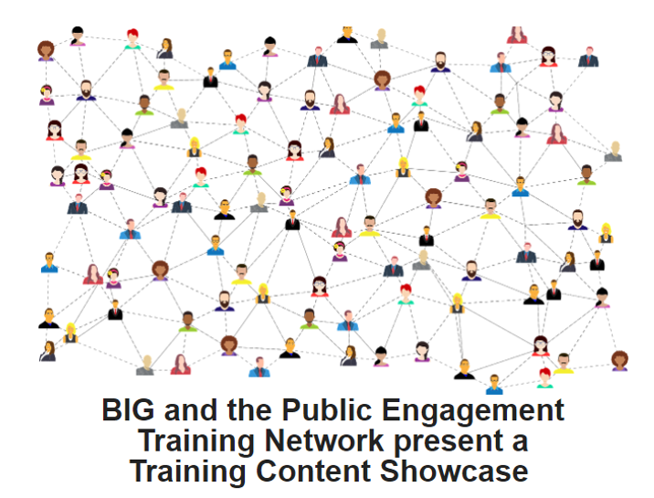
PET and SciComm Training Content Showcase
What are the Public Engagement training needs for a bio-medical research institute?
To build
Confidence
Competence
Skill Sets
To increase
Quality
Impact
PE helps researchers to create long-term impact & co-creation can achieve the deepest impact e.g. our Decode ME project https://www.decodeme.org.uk/

Slide 4
IGC Public Engagement & Communications Training Programme
A high strategic priority is inspiring and training our research workforce, within and beyond academic research
Our Public Engagement & Communications Training Programme
Builds confidence and competence, by developing and consolidating science communication and engagement skills amongst our staff and students
Develops skills required for public engagement
for a range of specific events, activities and competitions
to engage with our strategic target audiences
Increase awareness of barriers that exist for some of our public audiences, including those living with genetic conditions, cancers, disabilities and additional learning needs
To increase quality and the long-term impact of your research

Slide 5
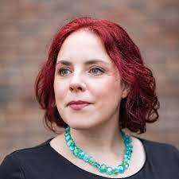
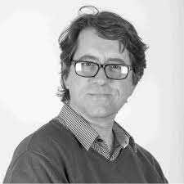
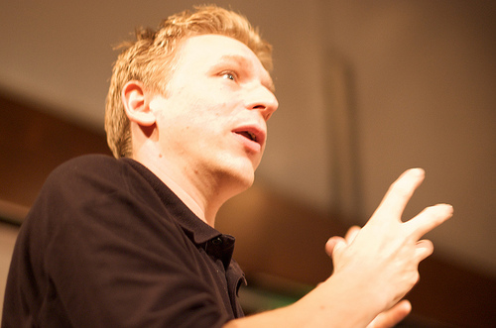
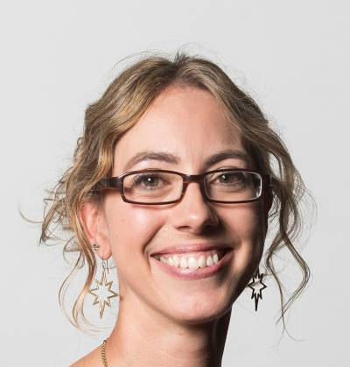
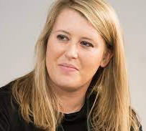
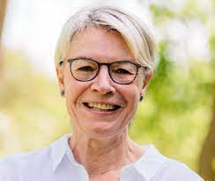
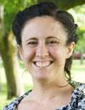
IGC Public Engagement & Communications Training Programme
Bringing in external expertise provides
Fresh insights
New perspectives
These inspire our research staff & students
External SciComm & PE Trainers are paid

Slide 6
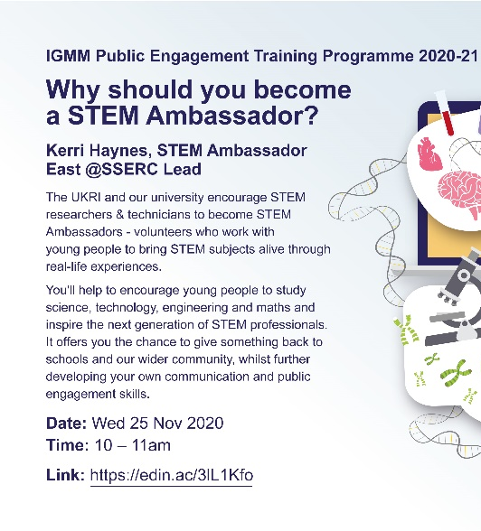
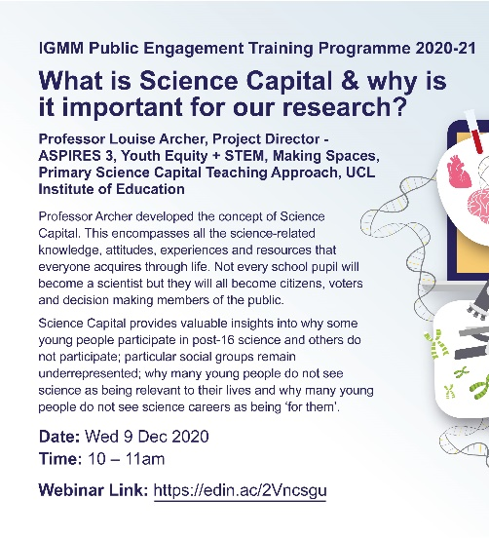
IGC Public Engagement & Communications Training Programme
Core training
Focuses on science communication and engagement skills
To become better presenters and writers
To learn to actively listen to and engage with different stakeholders
Training sessions
Introduction to Public Engagement 1 – What is it & how can you get involved
Introduction to Public Engagement 2 - Developing confidence and competence
Creating new PE events, workshops, activities and resources e.g. IDEATION – Dr Steve Cross
The STEM Ambassador Programme - Kerri Haynes, STEM Ambassador East, SSERC
Science Capital: Trainer - Prof Louise Archer, UCL

Slide 7
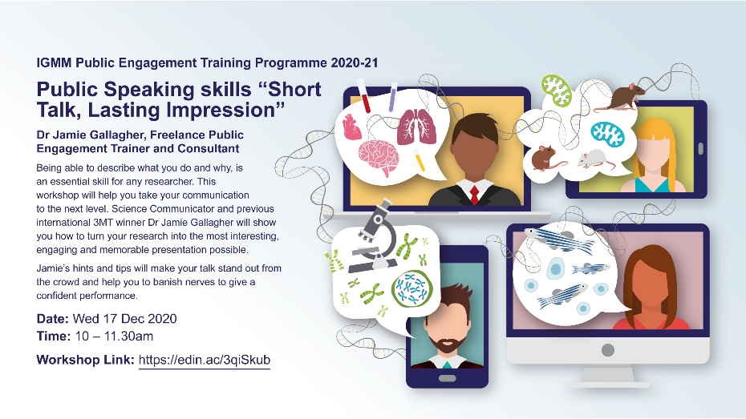
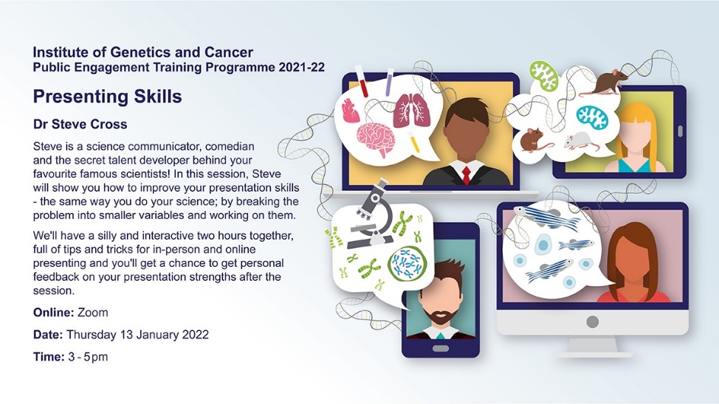
IGC Public Engagement & Communications Training Programme
Core training
Public speaking training includes developing active listening skills to and how to engage with different stakeholders – how to open and facilitate dialogue
These include storytelling sessions such as “Why are stories important and why should we use stories for communicating science?” delivered by Dr Kat Arney
Training sessions
Public Speaking 1 - Developing confidence and competence
Public Speaking 2 - Storytelling
Public Speaking 3 - Competitions (e.g. 3MT/ FameLab etc.)
Public Speaking 4 - Presenting & Engaging ONLINE
Public Speaking 5 - Debate & Dialogue · Developing the voice of Young Scientists
Public Speaking 6 - Ethical & Social Implications of Research – Understanding public expectations & concerns (The Civic Duty of Researchers)
Public Speaking 7 - The ‘Use of Animals in Research’
Public Speaking 8 - Creating Podcasts or Videos
Public Speaking 9 - Working with the Media

Slide 8
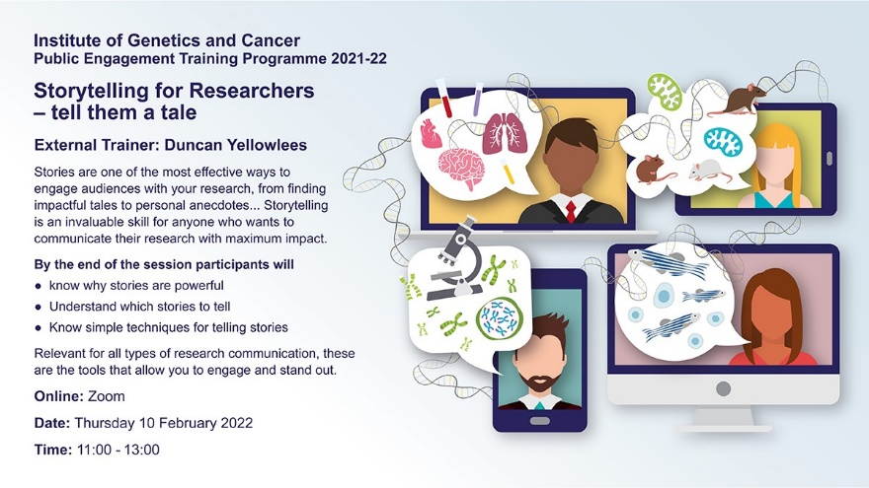
IGC Public Engagement & Communications Training Programme
Core training
Training sessions
Science Writing for the Public 1 - Articles
Science Writing for the Public 2 - Competitions (e.g. MRC Max Perutz)
Science Writing for the Public 3 – Blogs & Vlogs
Science Writing for the Public 4 - Lay Summaries
Science Writing for the Public 5 – Lay Posters
Illustrating Research 1 - Data Visualisation and Infographics
Illustrating Research 2 - Making Animations

Slide 9
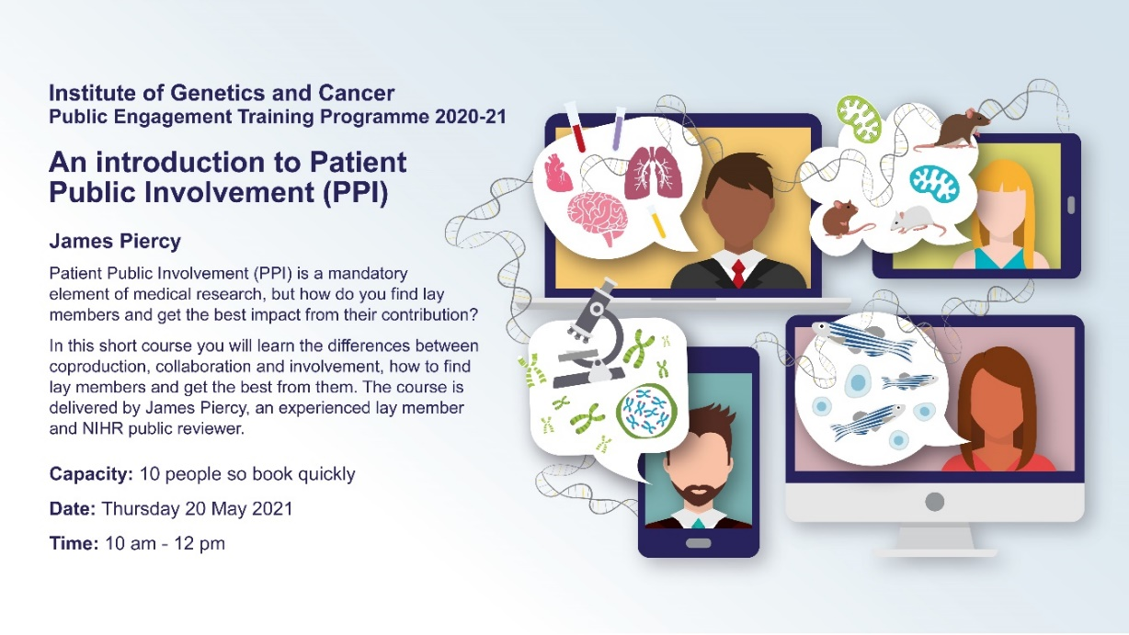
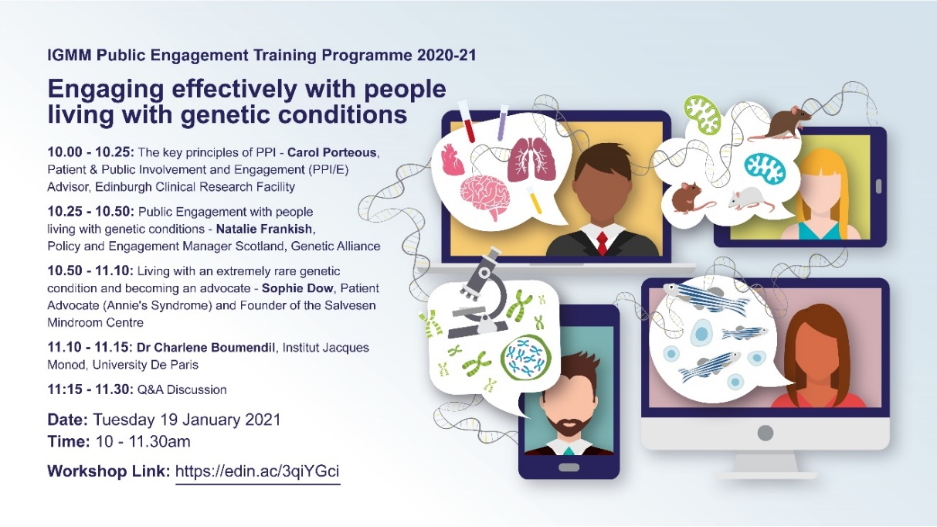
IGC Public Engagement & Communications Training Programme
Core training
Training sessions
PPI 1 - Patient & Public Involvement in Research – An Introduction
PPI 2 - Listening & Facilitation skills
PPI 3 - Co-Producing Research

Slide 10
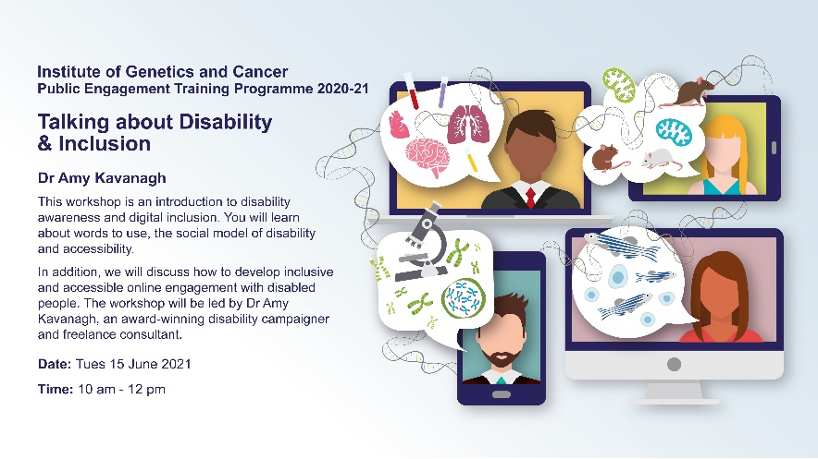
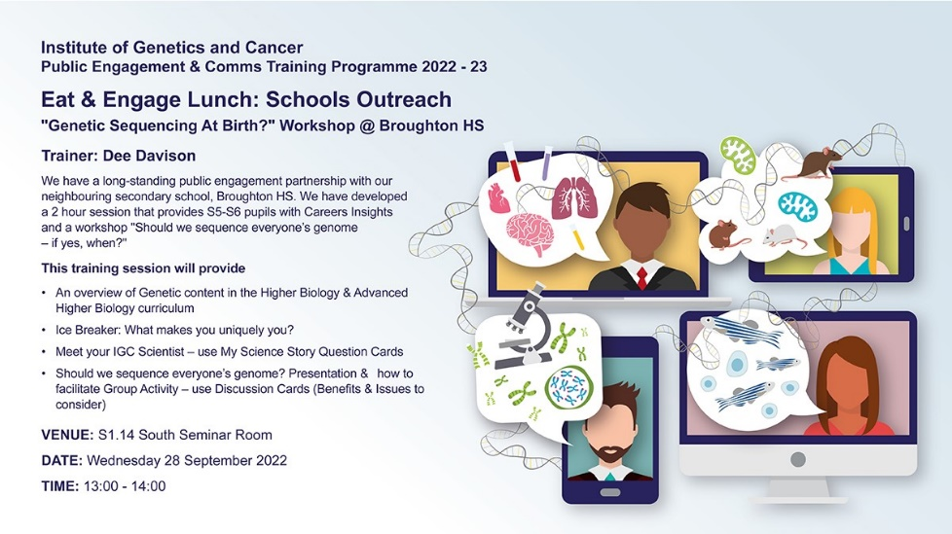
IGC Public Engagement & Communications Training Programme
Core training
Training sessions: Engaging with different target audiences (raise awareness of Equity, Respect & Safeguarding)
EDI in PE - Accessibility & Disability Awareness
EDI in PE – Accessibility & Disability Awareness - Autism Spectrum Disorders
Non-Biologists (in our increasingly Cross-Curricular Research) – engaging with Bioinformaticians, Chemists, Data Scientists, Engineers, Mathematicians, Medics, Physicists, Technologists etc.
PPI - People living with Genetic Conditions & Cancer, their relatives & carers, Patient Advocates & Charities - Working in Partnership
School Outreach – Engaging with Pupils & Teachers
School Outreach – Career Opportunities / Work Experience
Stakeholders, Policy Makers & Parliamentarians
Community Engagement

Slide 11
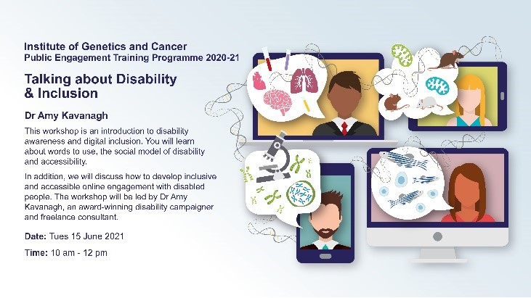
IGC Public Engagement & Communications Training Programme
Talking about Disability and Inclusion
An introduction to disability awareness and digital inclusion, learning about which words to use and the social model of disability and accessibility. Participants learned how to develop inclusive and accessible online engagement with disabled people. The workshop was led by Dr Amy Kavanagh, an award-winning disability campaigner and freelance consultant
This was a particularly impactful training session that really changed attendees’ perspectives and attitudes. “This was a brilliant session! I think this would be helpful for everyone at the University - both for teaching and public engagement” and “I gleaned so much and in a really positive way, it made me consider stuff from a different perspective.”
Equality, Diversity & Inclusion are guiding principles in our pursuit of academic excellence e.g. Rosie Russell, our previous Health and Safety Manager, who is Trans, ran sessions on ‘Being LGBT+ in the workplace’ for Fife Schools ‘Diversity’ Day in February 2019

Slide 12
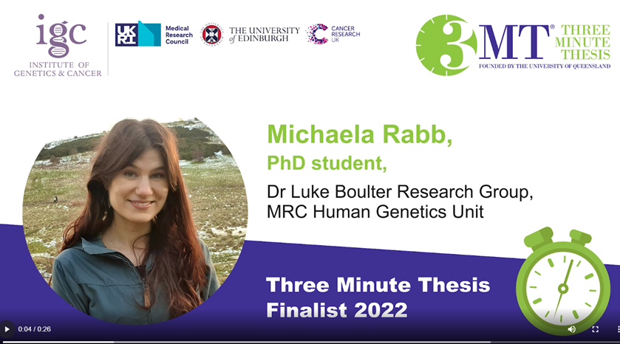
IGC Public Engagement & Communications Training Programme
Specific skills development training sessions are science presentation and writing competitions e.g.
Three Minute Thesis
FameLab
MRC Max Perutz Award
This investment in training has resulted in great success in these competitions
2020: 5 IGC PhD students submitted - 140 entries. 10 articles shortlisted. Our PhD student, Sarah Taylor won with "Curing the incurable - teaching an old drug new tricks to fight ovarian cancer" 2021: Ross Hannah, PhD Student, was shortlisted for his essay “In-DNA Jones: readers of the lost mark”
2022: Michaela Rabb, won our university heat of 3MT & recently competed in the UK Heat, results TBC…
Scottish Universities Life Science Alliance (SULSA) Award
for outstanding early career scientists whose work shows excellent potential to make an impact in the field of life sciences.
March 2019: Dr Olga Murina, Research Fellow, MRC HGU won
Feb 2022: Dr Didier Devaurs, XD Fellow won

Slide 13
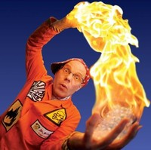
IGC Public Engagement & Communications Training Programme
April 2022: “Wow! Why! Aha!” - Dr Bunhead (Tom Pringle)
A special training Science Communication workshop was delivered over 1½ days for the new EpiCrossBorders PhD Programme
Tom used drama training techniques and experiential learning to encourage students to
learn new techniques and ways of thinking & doing
practice with each other
self reflect & provide constructive criticism to others
practice again
reflect again etc.
until they really understood how to share their own research effectively, be creative in doing so & felt comfortable opening dialogue about it
“The training made me want to try the 3 minute thesis competition. It also encouraged me to incorporate movement into a public engagement, either Dance your PhD, or a dance course for children to learn disease mechanisms”

Slide 14
IGC Public Engagement & Communications Training Programme
How do we embed PE and PE Training?
Undertaking PE is part of our staff & student’s annual Performance and Development Review (R&DR), so this helping to ensure the time for PE training & delivery is included in Work Plans
We are aiming to include undertaking PE in all our Job Descriptions
Staff & Students who deliver PE are recognised via IGC-wide emails, on our Intranet, in web stories and tweets
Our outstanding Postdocs are recognised through our college’s annual National Postdoc Appreciation Week Award for PE. Each campus is encouraged to nominate postdocs for 4 categories and those with the most nominations win!

Slide 15
IGC Public Engagement & Communications Training Programme
How do we embed PE and PE Training?
Core PE sessions are part of our PhD student’s annual training programme and attendance is proactively encouraged
The annual PEC programme is open to all staff & students. Attendance is high, initially dominated by PhD students but now attracting research staff, from all career stages, and technicians
Between 10-15 PEC training sessions are delivered annually, but previous sessions that were recorded are accessible to all via our Intranet
The 32 training sessions within our programme are rolled out over 3 years
Our staff & students are not required to attend all these sessions but pick the ones that appeal most to them - to build confidence, competence & skill sets and to help them to increase the quality & impact of their research

Slide 16
IGC Public Engagement & Communications Training Programme
We promote relevant training offered by
The University of Edinburgh
Institute of Academic Development
Wellcome Trust Edinburgh Clinical Research Facility (WTCRF)
The College of Medicine and Veterinary Medicine
The Edinburgh Research Office
The MRC
The NCCPE
ScotPEN
The Genetics Society
UK Parliament Knowledge Exchange Unit

Slide 17
IGC Public Engagement & Communications Training Programme
Evaluation
Our staff & students get to practice what they’ve learning through our training session when they engage with our target audiences, gaining real world experience
How confident researchers feel in communicating and engaging with the public
Researcher’s feelings and attitudes towards public interaction with their research
What has been learned from the engagement that is valuable to / impacts their own research
Was something unexpected learned through public engagement
In 2019, the University received a Leader in Openness Award from Understanding Animal Research in recognition of its sector-leading efforts. Dee works within our institute in do more to improve the health and wellbeing of people and models animals used in research. We aim to display the use of our zebrafish and mice models in the majority of our PE activities, including in public talks, all schools engagement initiatives, during building tours, at Doors Open Day, the MRC Festival, science festivals etc.

Slide 18
IGC Public Engagement & Communications Training Programme
Evaluation
How confident researchers feel in communicating and engaging with the public
Researcher’s feelings and attitudes towards public interaction with their research
What has been learned from the engagement that is valuable to / impacts their own research
Was something unexpected learned through public engagement
In 2019, the University received a Leader in Openness Award from Understanding Animal Research in recognition of its sector-leading efforts. Dee works within our institute in do more to improve the health and wellbeing of people and models animals used in research. We aim to display the use of our zebrafish and mice models in the majority of our PE activities, including in public talks, all schools engagement initiatives, during building tours, at Doors Open Day, the MRC Festival, science festivals etc.

Slide 19
Thank you
Dee Davison, Public Engagement Manager
Institute of Genetics and Cancer, Western General Hospital Campus, University of Edinburgh
Working pattern - 3 DAYS: Tuesday - Thursday, 08:30-17:30
E:dee.davison@ed.ac.uk M: 07963 058634
Institute of Genetics and Cancer (previously known as the IGMM): https://www.ed.ac.uk/institute-genetics-cancer
MRC Human Genetics Unit (HGU) www.ed.ac.uk/mrc-human-genetics-unit
Centre for Genomic and Experimental Medicine (CGEM) www.ed.ac.uk/centre-genomic-medicine
Cancer Research UK – Scotland Centre (CRUK SC) www.ed.ac.uk/cancer-centre
Follow us on Twitter
@EdinUni_IGC
@mrc_hgu
@EdinCRC
@UoE_CGEM

