Slide 1
Stories from the Stage: Providing, presence, awareness of self and self confidence in public speakers
Martin Khechara
Associate Prof for Engagement in STEM

Slide 2
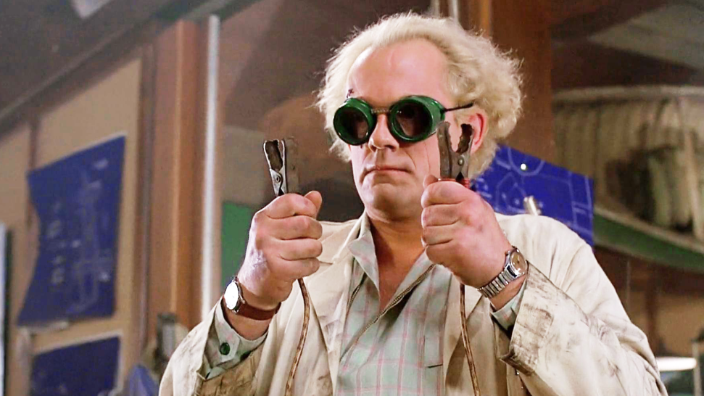
I am a scientist educator and researcher…

Slide 3
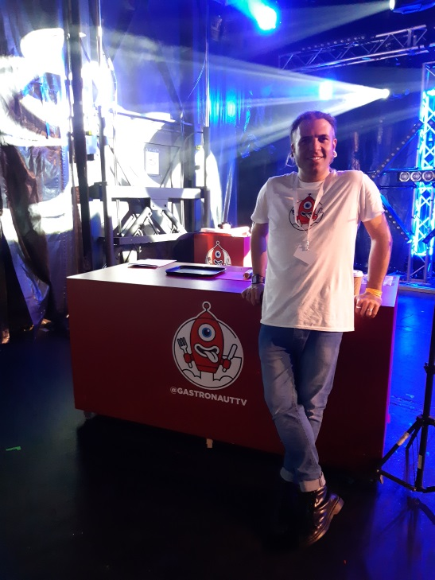
I am a science performer, presenter, writer, producer, trainer and director….
…..I communicate that’s my job!

Slide 4
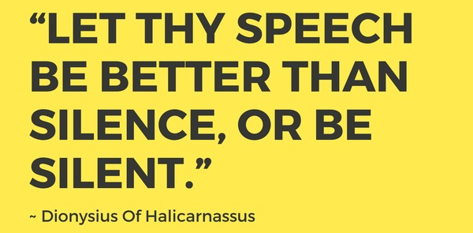

Slide 5
P.V.L.E.G.S

Slide 6
PVLEGS
POISE, presence and pitch
VOICE
LIFE
EYE CONTACT
GESTURES
SPEED

Slide 7
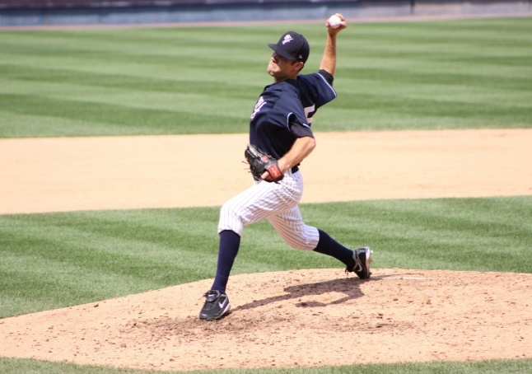
P – poise, presence and pitch
The main aim is to help a speaker to appear calm, confident and avoid distracting mannerisms. An appreciation of academic pitch is essential.
Practice for adaptability for adlib using improvisation is a good tool.

Slide 8
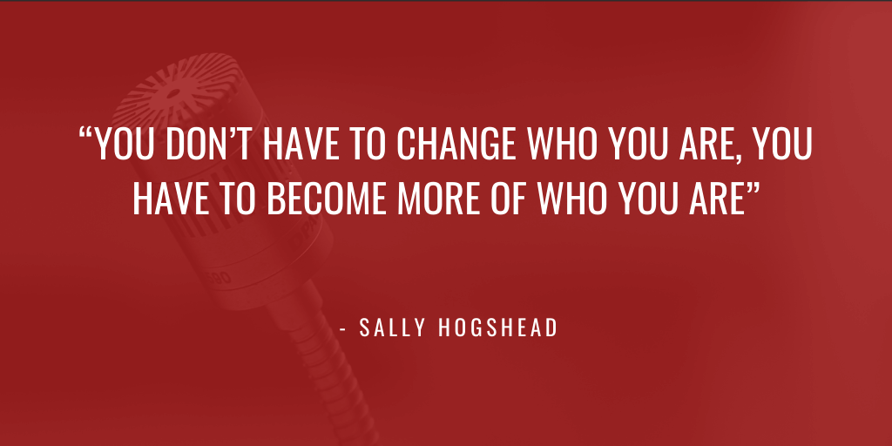

Slide 9
V – Voice
The aim is to coach participants to speak clearly, plainly, in an inclusive way and without an interrogative tone!
People do not for the most part know that the space they look into controls volume.

Slide 10
L – Life
The aim is to allow participants to practice expressing passion and emotions about a subject and apply this to public speaking.
This is intimately linked with the use of gestures, spoken language and body language. Again aspects of performance can give confidence and break down the barrier of embarrassment.

Slide 11
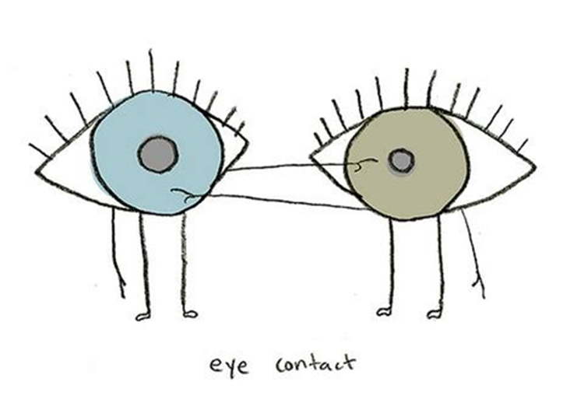
E – Eye contact
The aim is to practice engaging in audience feedback through eye contact and stress the importance in the cycle of communication.
The structure of presentations is a key consideration.

Slide 13
G - Gestures
The aim here is to show the importance of gestures and body language to give a genuine, honest and engaging delivery.
An awareness of the importance of ‘self’ is a key point.
Just remember 7, 38, 55.

Slide 14
A quick group exercise…….
Do exactly as I say

Slide 15
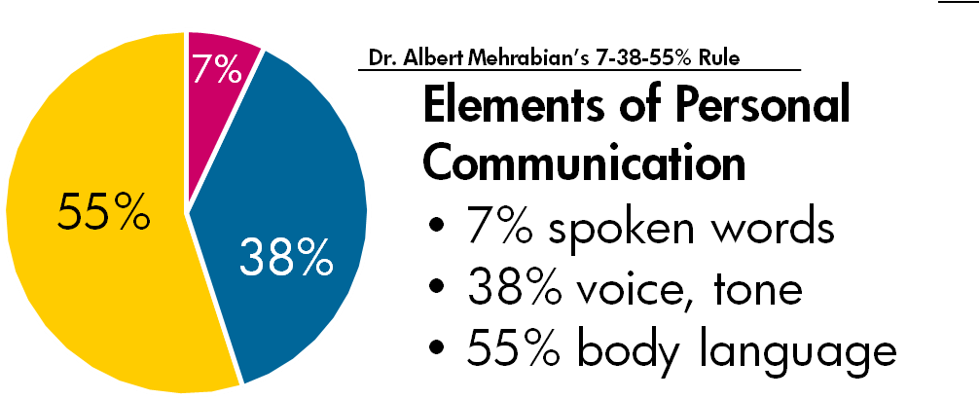
First presented in the book ‘Silent messages study’

Slide 16
S – Speed
The aim is to generate confidence in using different pace and rhythm for emphasis and drama with the confidence not to fill space with waffle.
There is power in a pause.

Slide 17
