Slide 1
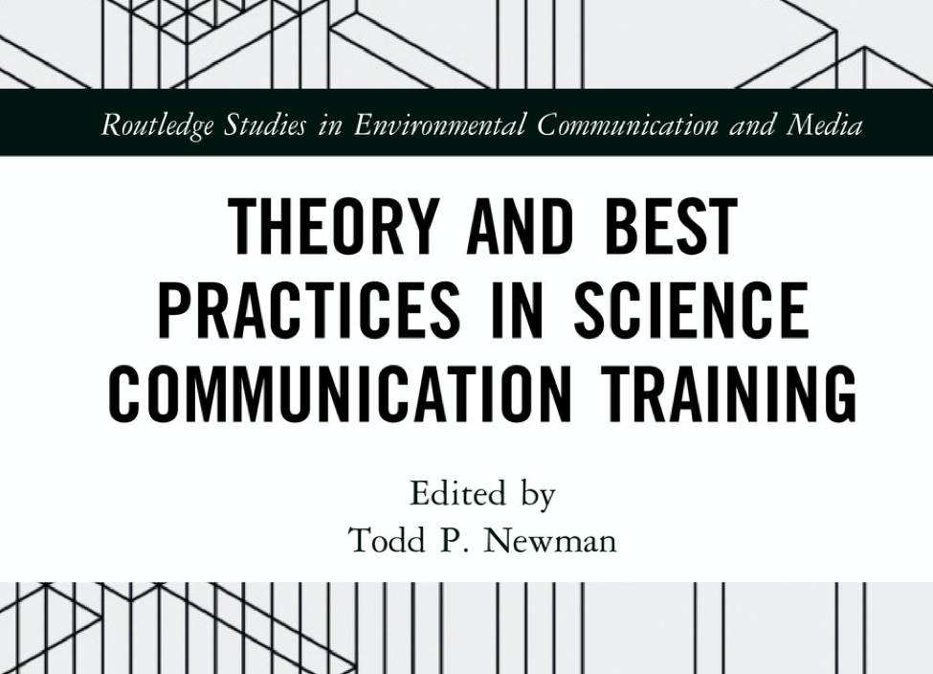
Food for thought (and practice)
Golden nuggets from the book, “Theory and Best Practices in Science Communication Training,”
Ed. Todd P. Newman (2019/2020)
Notes:
Image - https://www.edx.org/course/food-for-thought

Slide 2
Chapters
Part 1. The Scientist as a Strategic Communicator
Scientists, Trainers, and the Strategic Communication of Science
What Studies of Expertise and Experience Offer Science Communication Training
The Meaning of Public-Private Partnerships for Science Communication Research and Practice
Science Engagement and Social Media: Communicating Across Interests, Goals, and Platforms
Part 2. Science Communication Training Design and Assessment
Training Scientists to Communicate in a Changing World
The Challenges of Writing Science: Tools for Teaching and Assessing Written Science Communication
Insights for Designing Science Communication Training from Formal Science Education: Apply the Mantra and be Explicit
Evaluating Science Communication Training: Going Beyond Self-Reports
Part 3. Future Directions for Science Communication Training
Abandoning the Runaway Train: Slowing Down to Draw on Lessons Learned from Health Communication Training
A Metro for Science Communication: Building Effective Infrastructure to Support Scientists’ Public Engagement

Slide 3
Chapters
Part 1. The Scientist as a Strategic Communicator
Scientists, Trainers, and the Strategic Communication of Science
What Studies of Expertise and Experience Offer Science Communication Training
The Meaning of Public-Private Partnerships for Science Communication Research and Practice
Science Engagement and Social Media: Communicating Across Interests, Goals, and Platforms
Part 2. Science Communication Training Design and Assessment
Training Scientists to Communicate in a Changing World
The Challenges of Writing Science: Tools for Teaching and Assessing Written Science Communication
Insights for Designing Science Communication Training from Formal Science Education: Apply the Mantra and be Explicit
Evaluating Science Communication Training: Going Beyond Self-Reports
Part 3. Future Directions for Science Communication Training
Abandoning the Runaway Train: Slowing Down to Draw on Lessons Learned from Health Communication Training
A Metro for Science Communication: Building Effective Infrastructure to Support Scientists’ Public Engagement

Slide 4
Scientists, trainers, and the strategic communication of science
Nichole Bennett, Anthony Dudo, Shupei Yuan, John Besley
Scientists should communicate but not all can, so improve the quality of those that do.
Potential disconnect between what research indicates and what trainers actually teach.
Learning of skills doesn’t necessarily lead to increased impact
Premise
Consider helping scientists to communicate in a strategic way, to maximise the desired effect of their communications by following indications from research.
G-O-T: Think in terms of Long-term behavioural goals, short-term communication objectives, and tactics to achieve objectives.
Trainers could customise and align efforts to specific communication goals of scientist, whilst providing insight into the range of possible objectives and goals.
Proposal
Notes:
Image - https://welpmagazine.com/complete-guide-to-strategic-management-for-small-business/

Slide 5
Scientists, trainers, and the strategic communication of science
Nichole Bennett, Anthony Dudo, Shupei Yuan, John Besley
Consider the Theory of Planned Behaviour (Attitude, efficacy, norms) to assess willingness of scientists to communicate with public.
Considering Efficacy (Self, response, time) would mean we might promote or aim to Improve skills, beliefs about impact, and available time to communicate.
Frame issues to resonate with audience.
How to demonstrate warmth and caring, but still be authentic rather than dishonest or untruthful.
Relationship building: Content doesn’t matter “unless a healthy dynamic for information exchange exists”.
Choose objectives for their effectiveness as supported by social science research.
Supplement skills training with basic communication theories and models
Consider highlighting objectives that suit the presenter’s communication style.
Trainers and social scientists partner to understand, monitor and maximise training efforts.
Pointers
Notes:
Image - https://www.viewsonic.com/library/blended-learning-in-education-3-0/

Slide 6
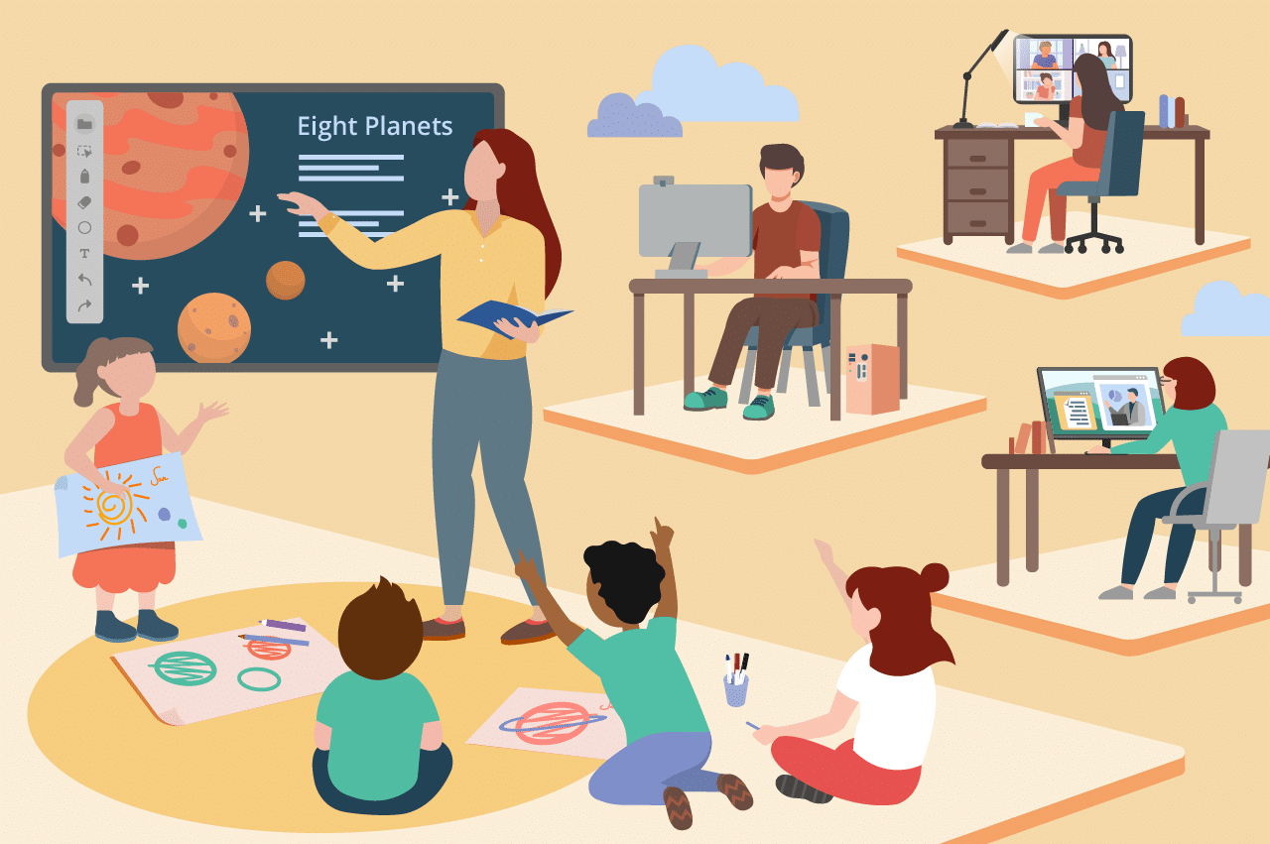
Insights for Designing Science Communication Training from Formal Science Education: Apply the Mantra and be Explicit
Louise Kuchel
Most people who teach or train others have not been trained in how to design learning activities, assessment or evaluation.
Premise
Look at commonalities between effective communication and effective teaching and apply teaching methods to communication training.
Proposal

Slide 7
Insights for Designing Science Communication Training from Formal Science Education: Apply the Mantra and be Explicit
Louise Kuchel
Distinguish between formal education and independent/professional development, as the goals and constraints are different. Same goes for training scientists compared to communicators.
Learning is influenced by motivation, practice, feedback, reflection, fun & play (Race, 2014). Build them into activity design.
Constructivism links new knowledge and experiences to existing knowledge and experiences.
Backwards design & constructive alignment to organise and focus training: Outcomes based, so start with learning goals and outcomes, then how to evidence/assess them, then activities to experience/practice desired learning.
Make explicit and visible the links between goals, assessment and learning activities.
1. Identify tacit steps in complex communication processes.
2. Work out how to convey those steps clearly to non specialists
3. Locate variety of frameworks and evidence to develop clear, actionable goals for training
4. Goals that go beyond application of skills
Pointers
Notes:
Race, P (2014) Making Learning Happen: 3rd edition, London: Sage

Slide 8
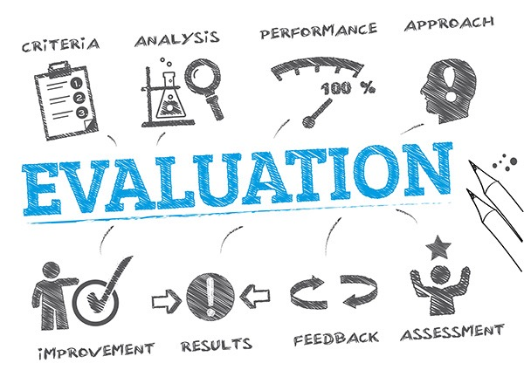
Evaluating Science Communication Training: Going Beyond Self-Reports
Yael Barel-Ben David and Ayelet Baram-Tsabari
Few measures exist to determine training success or ways to improve.
Premise
To determine effectiveness, training programs need to define specific goals and incorporate rate models of evaluation before, during and after the intervention.
Proposal
Notes:
Image - https://unctad.org/about/evaluation

Slide 9
Evaluating Science Communication Training: Going Beyond Self-Reports
Yael Barel-Ben David and Ayelet Baram-Tsabari
Diagnostic < - - - Formative - - -> Summative assessments/evaluations
-<-> - <-> - < - Process - - - - - - - - - - -> Impact
Clearly define learning goals (e.g. Baram-Tsabari & Lewenstein, 2017) and outcomes.
Goals influence tools for data collection - e.g. Self reports, surveys, interviews, external evaluations (best for skills).
Use several validated and reliable instruments when evaluating to strengthen validity and findings.
Be aware of limitations i.e. timing, funds, trained manpower, attention spans and phrasing of questions.
Kirkpatrick model (1967) - Reaction (views, attitudes and perceptions), Learning (acquired knowledge), Behaviour (change in practice), Results (overall, in relation to goals).
Pointers
Notes:
Ayelet Baram-Tsabari & Bruce V. Lewenstein (2017) Science communication training: what are we trying to teach?, International Journal of Science Education, Part B, 7:3, 285-300, DOI: 10.1080/21548455.2017.1303756

Slide 10
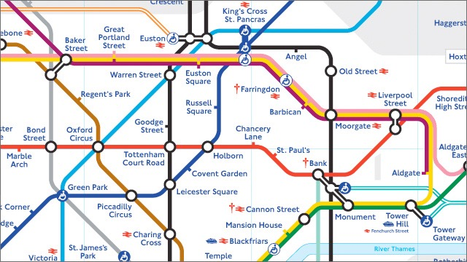
A Metro for Science Communication: Building Effective Infrastructure to Support Scientists’ Public Engagement
Brooke Smith
With the blossoming of science communication there is an increasing number and diversity of goals and objectives and methods for achieving them. Scientists are spending time, energy and resources to communicate within this landscape, but perhaps not as effectively as they could.
Premise
We should consider building an infrastructure (like a Metro) to help scientists navigate to their communication destinations more effectively.
Proposal

Slide 11
A Metro for Science Communication: Building Effective Infrastructure to Support Scientists’ Public Engagement
Brooke Smith
Metro Stops (SciComm destinations) are the goals and objectives, that should be clearly articulated.
Metro lines (Communication and engagement pathways) are the connections needed (e.g. methods, organisations and people) to navigate stops (objectives) to reach the final destination (goal). Connect training to real world engagement opportunities.
Engineering the Metro (Research and data to build and evaluate SciComm). How to plan, monitor and maintain communications in a reliable and evidence informed way. This relies on input from (and access to) many different fields to achieve success. (E.g. psychology, STS, education, natural sciences, communications etc). We can help connect the dots and also provide evaluation training.
Metro Transit Authority (Central coordination for SciComm). A central entity to link up and help coordinate efforts between the different organisations involved in the SciComm ecosystem.
Metro Rules and social norms (Policies and a culture for SciComm). Currently, these can sometimes be unsupportive or even obstructive. Recognise these and promote active voices for change.
Might also explore SciComm ethics e.g. Should we use certain tactics/measures?
Financing and building the Metro: Investing in the SciComm infrastructure. There’s user generated revenue, or perhaps government funding.
Pointers

